Slide 1
SPARKLE(2) SCHWAEMM128-128 구현
발표자: 양유진
링크: https://youtu.be/Qd1vqOmZCWc

Slide 2
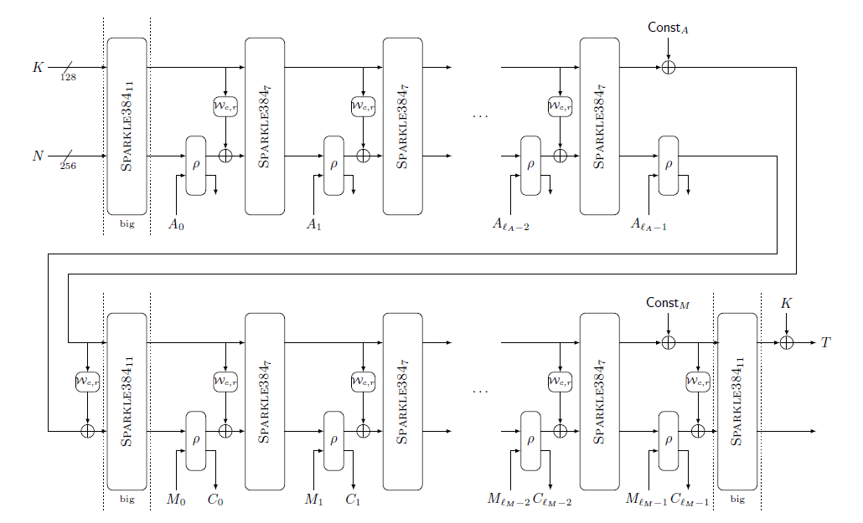









SCHWAEMM128-128 구현
Data block size: 16-bytes(128-bits)
Key length: 128-bits
Nonce length: 128-bits
Tag length: 128-bits
plain text: 32-bits (가정)
cipher text: 32-bits (가정)
authenticated data: 32-bits (가정)
n(Internal state size): 256-bit
r(size of rate): 128-bit
c(size of the capacity): 128-bit
128
$${SPARKLE256}_{10}$$
$${SPARKLE256}_{7}$$
$${SPARKLE256}_{7}$$
$${SPARKLE256}_{7}$$
128
$${SPARKLE256}_{10}$$
$${SPARKLE256}_{7}$$
$${SPARKLE256}_{7}$$
$${SPARKLE256}_{7}$$
$${SPARKLE256}_{10}$$
The Authenticated Encryption Algorithm SCHWAEMM128-128 with rate r=128 and capacity c=128

Slide 3
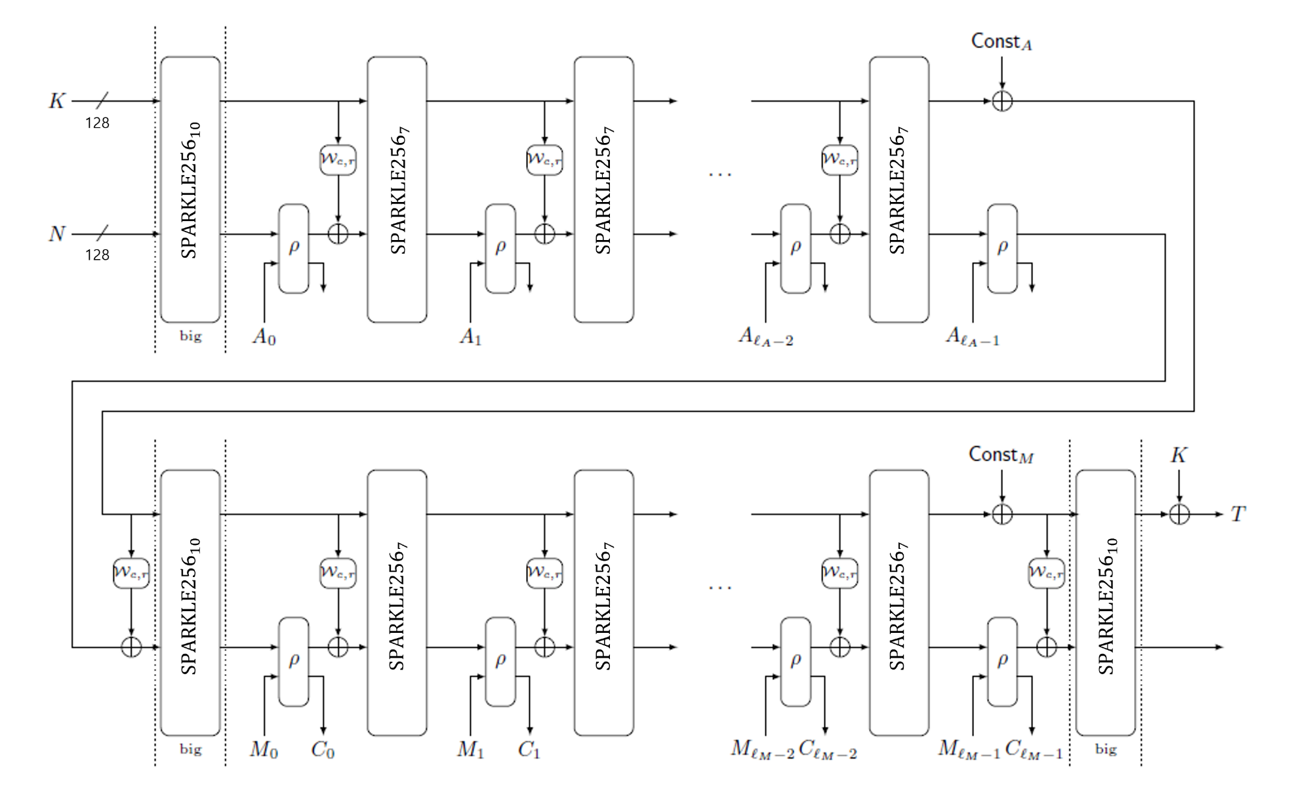
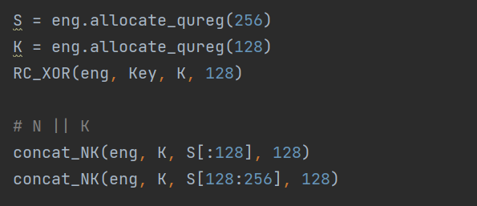

SCHWAEMM128-128 구현
SR
SL
SR
SL

Slide 4
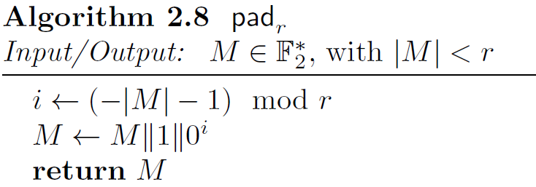
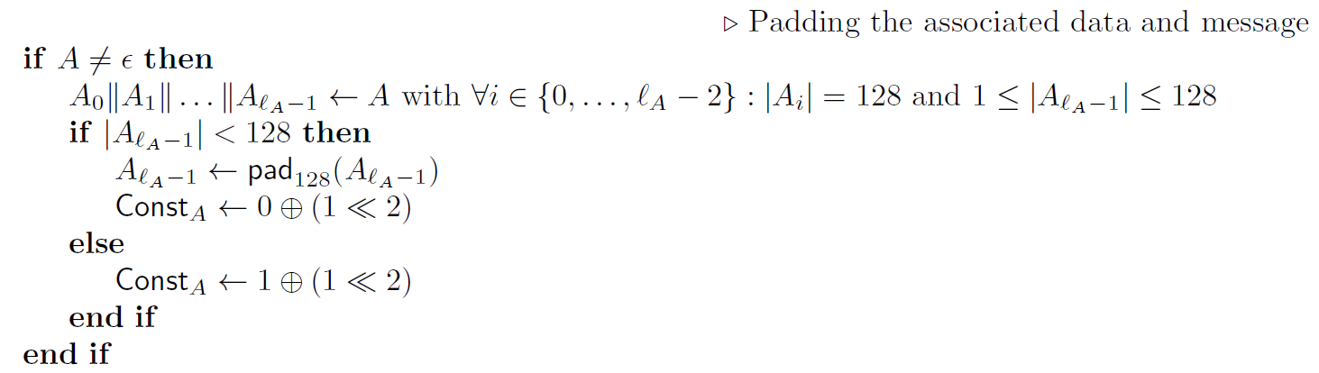


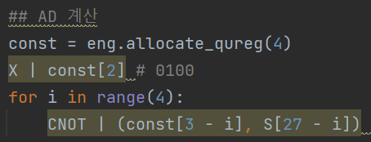
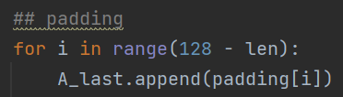
SCHWAEMM128-128 구현
1<<2 = 4

Slide 5









SCHWAEMM128-128 구현
$$S_{1}$$
$$S_{2}$$
$$S_{2}$$
$S_{2}$ $⨁$ $S_{1}$
$$S_{2}$$
${(S}_{2}$ $⨁$ $S_{1})$ $⨁$ $D$
$S ⨁$ $D$

Slide 6
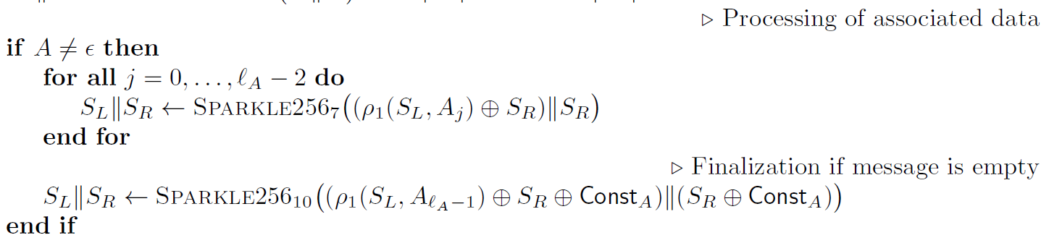
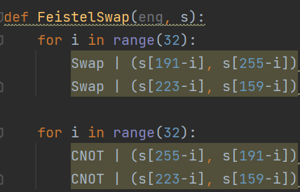
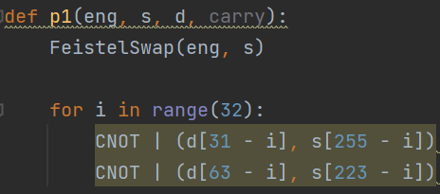
SCHWAEMM128-128 구현

Slide 7

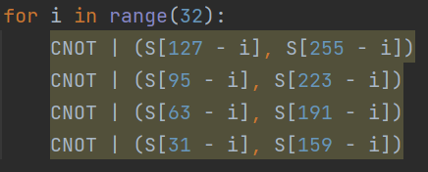

SCHWAEMM128-128 구현
SR
SL

Slide 8
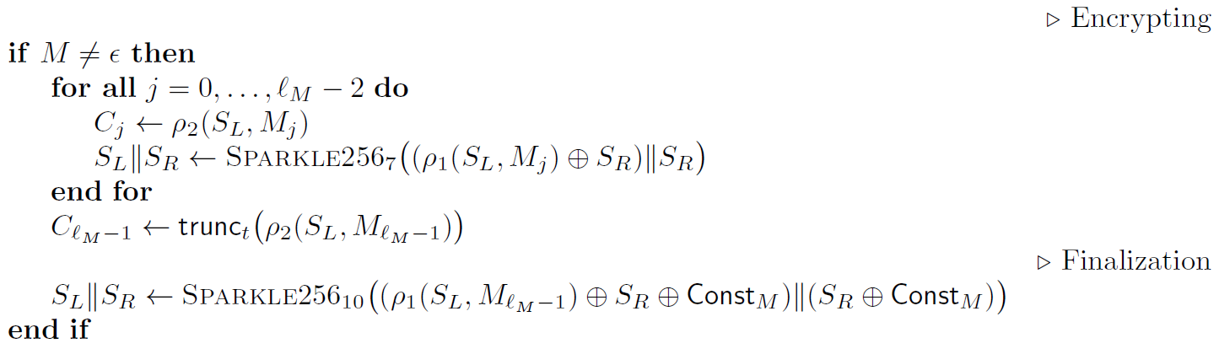
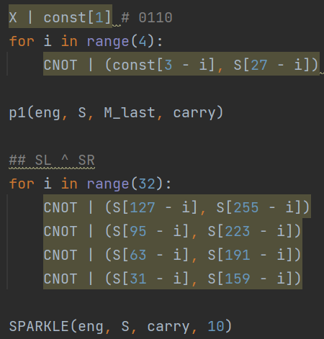
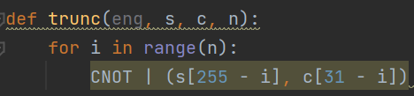
SCHWAEMM128-128 구현

Slide 9

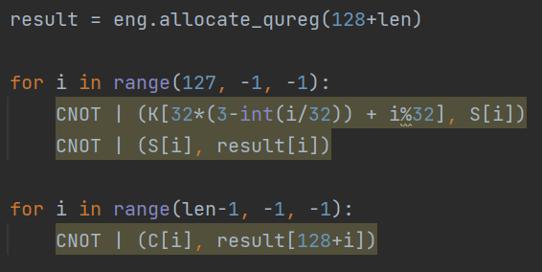
SCHWAEMM128-128 구현

Slide 10


SCHWAEMM128-128 구현(결과)
[입력]
PlainText(32-bit): 0x03020100
Authenticated Data(32-bit): 0x03020100
Key(128-bit): 0x0F0E0D0C0B0A09080706050403020100
Nonce(128-bit): 0x0F0E0D0C0B0A09080706050403020100
[출력]
CipherText(128-bit): E21B16E5 3524DA18 39758C58 BA6AE225 ADEB5479
→ E5161BE2 18DA2435 588c7539 25E26ABA 7954EBAD
[python code 결과]
Notes:
Little-endian

Slide 11
감사합니다

